Slide 1
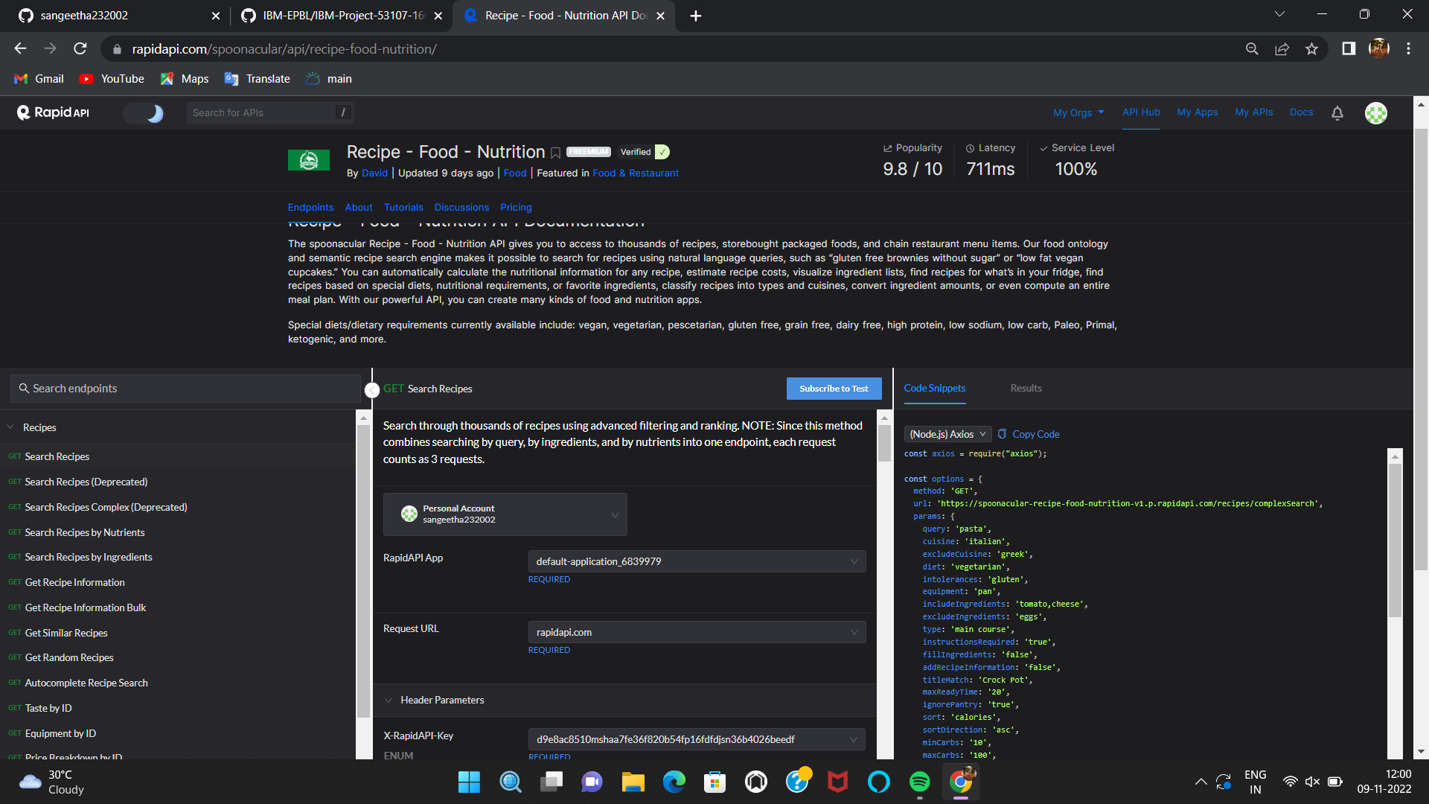
Environment Setup
Nutrition API Account Creation
Team ID : PNT2022TMID07573
Shreetha.M(TL)

Slide 2
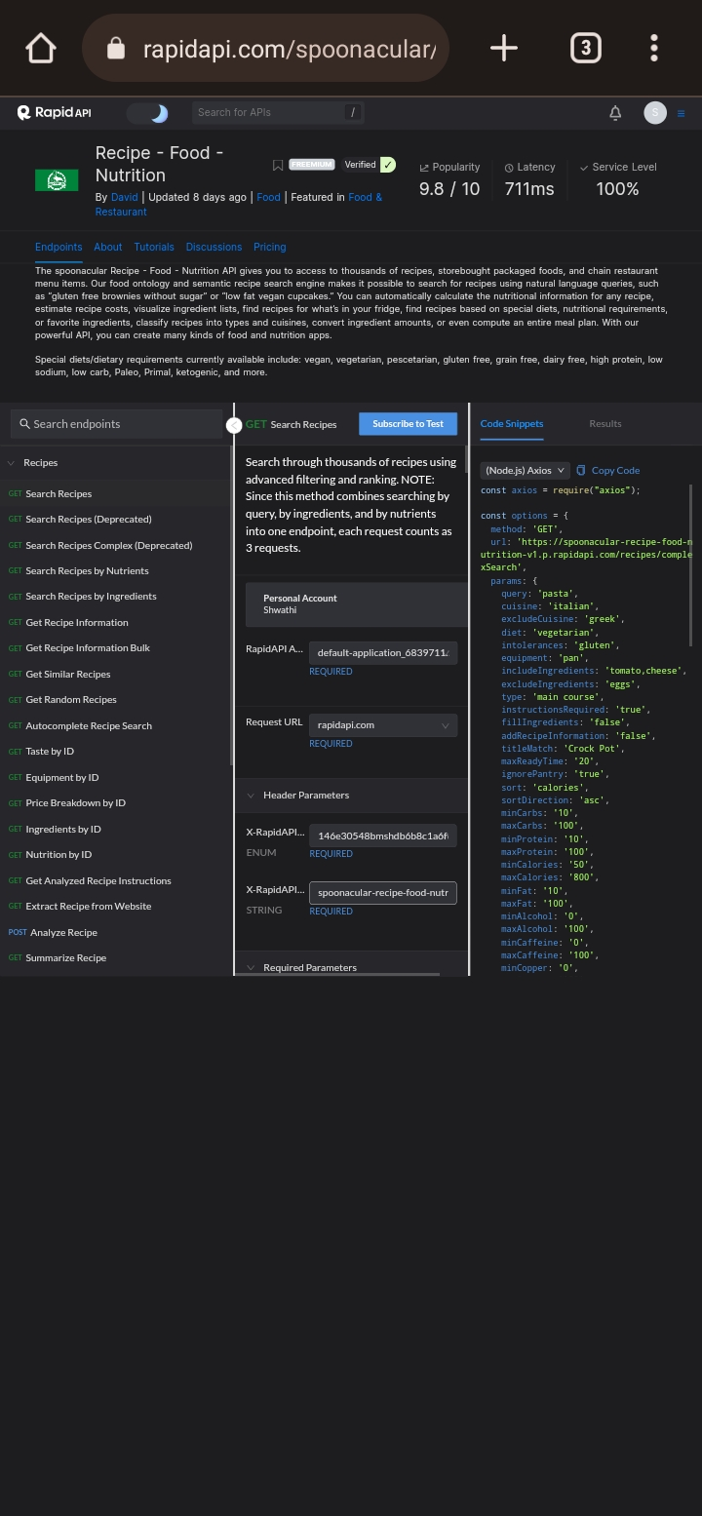
Shwathi.R.M

Slide 3
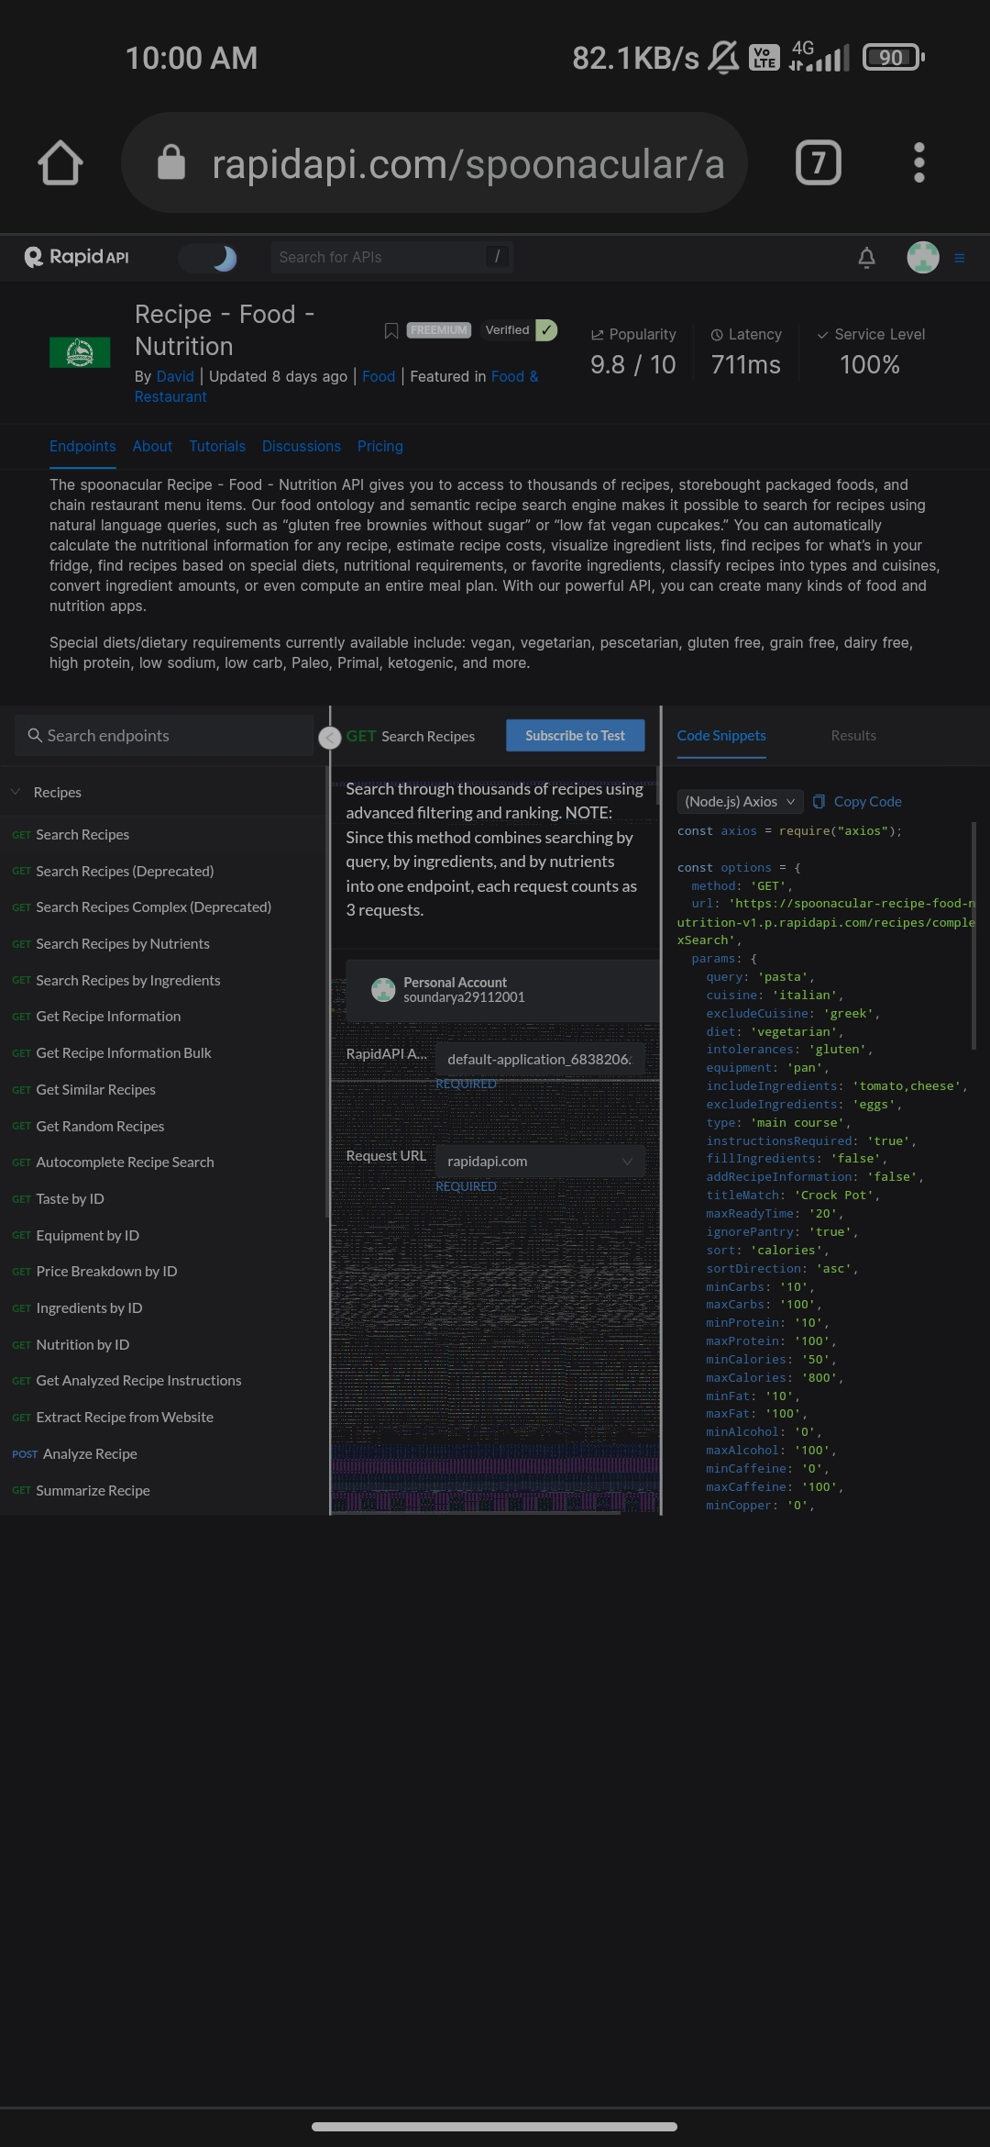
Soundarya.D

Slide 4
Sangeetha.S

